Slide 1


Setup Jupyter environments for data scientists
https://github.com/Tuxae/Tuxae-Jupyter-Manager
Technologies: Docker, Jupyter, Letsencrypt, Nginx proxy, Flask, UWSGI
Author: Aurélien Duboc <aurelien@duboc.xyz>

Slide 2
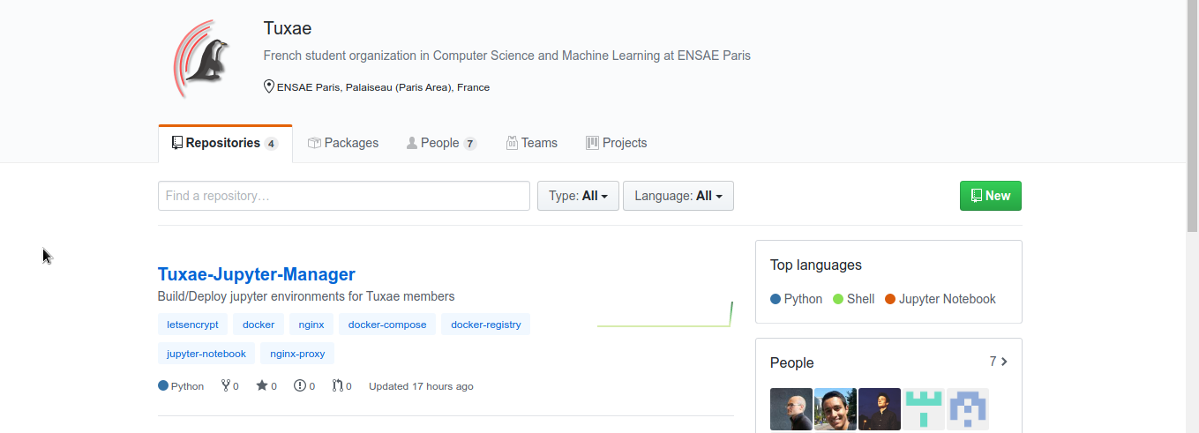
Github Tuxae

Slide 3
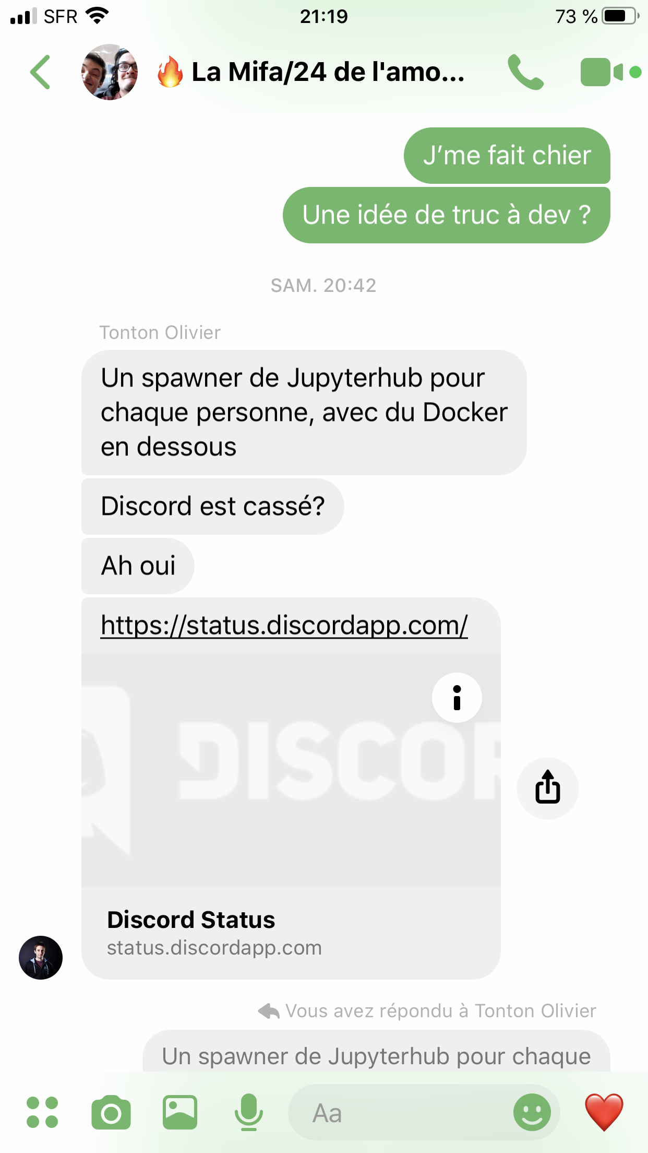
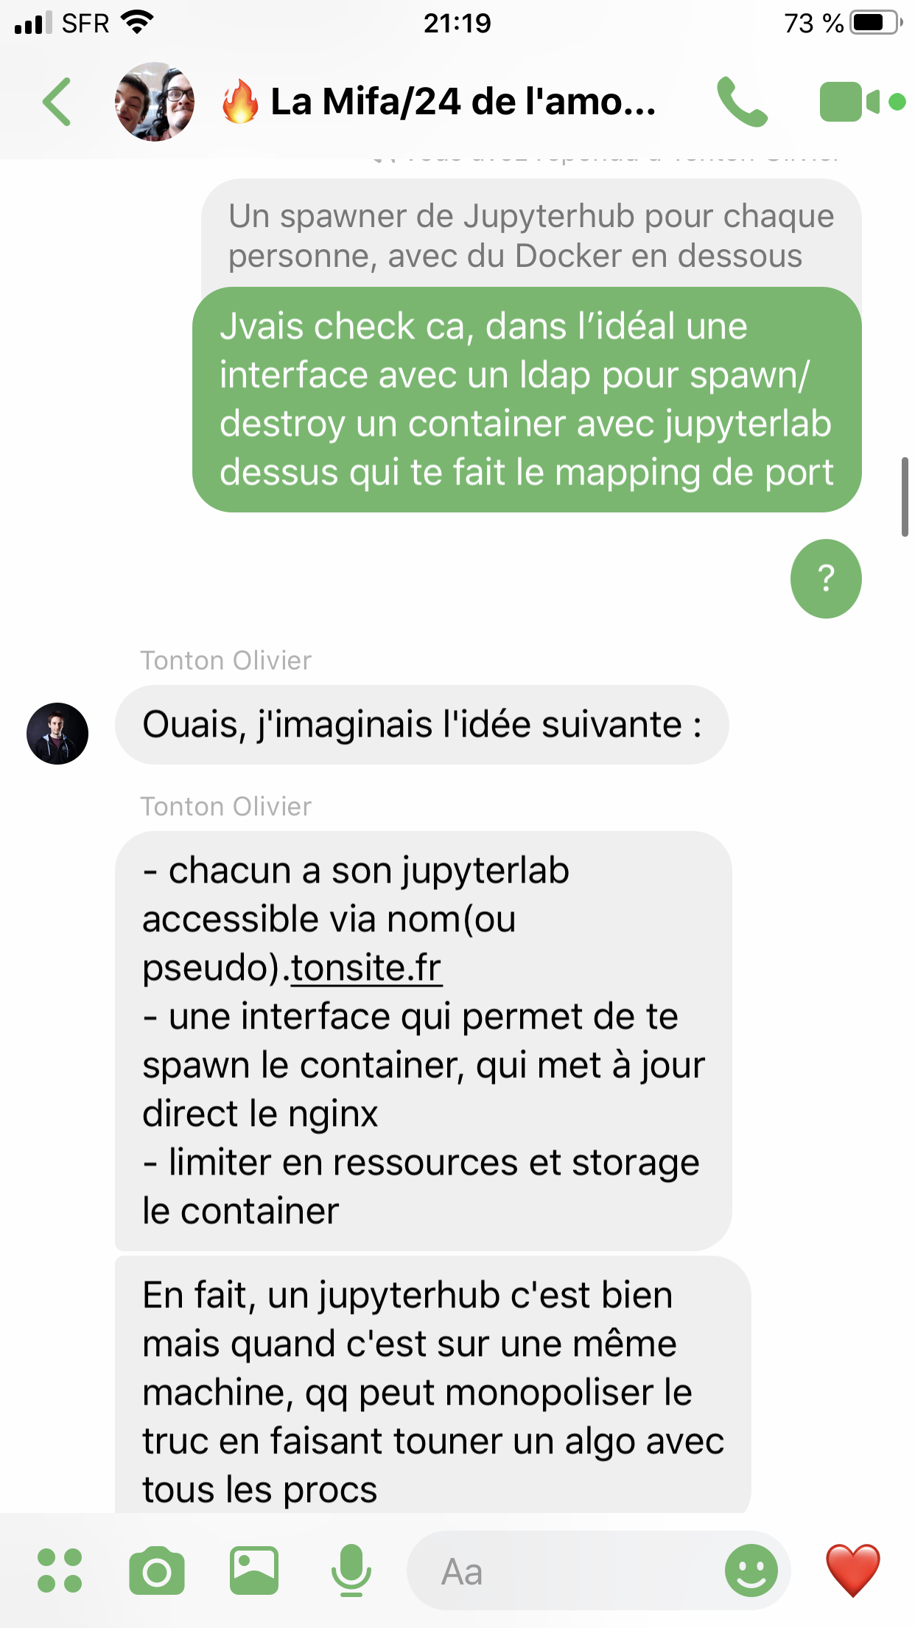
Last saturday

Slide 4
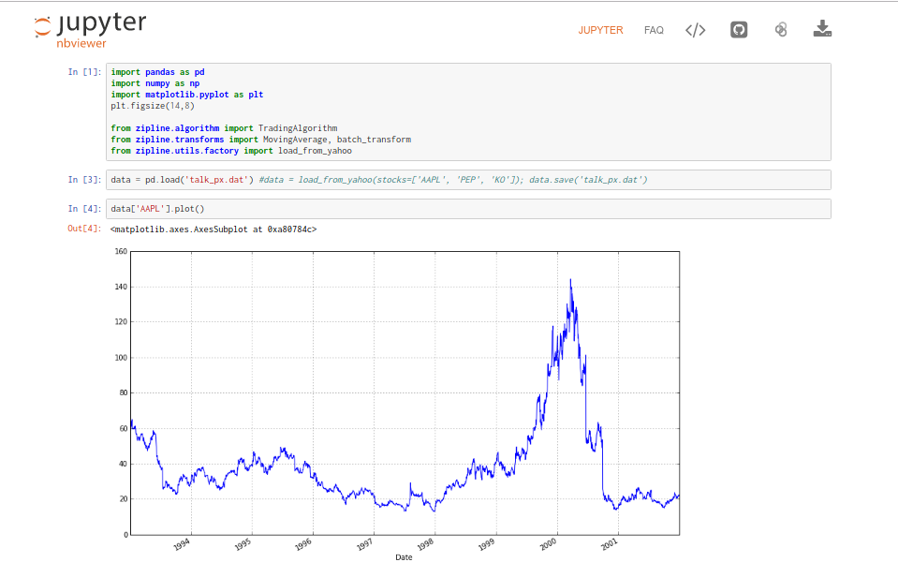
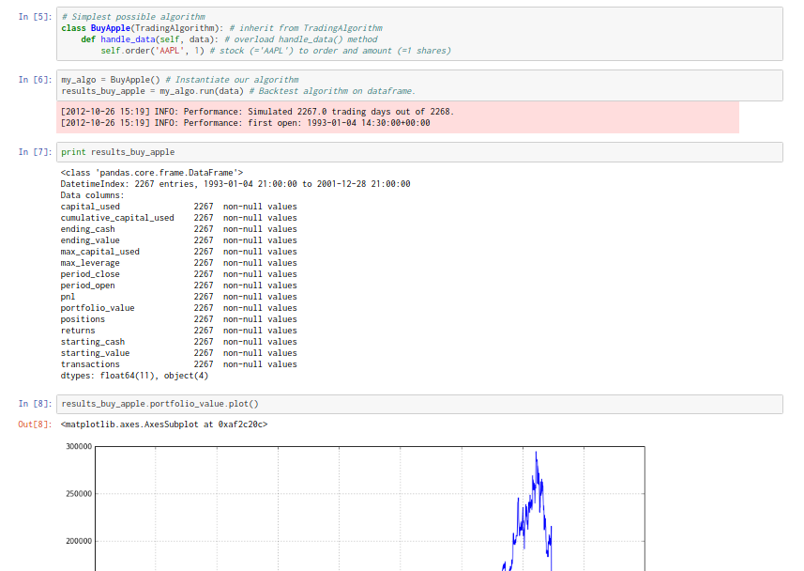
Finance application

Slide 5



Finance application
TRO B1 LA THUNE

Slide 6
What do I need ??

Slide 7

Step1: a well-rested body for more energy

Slide 8
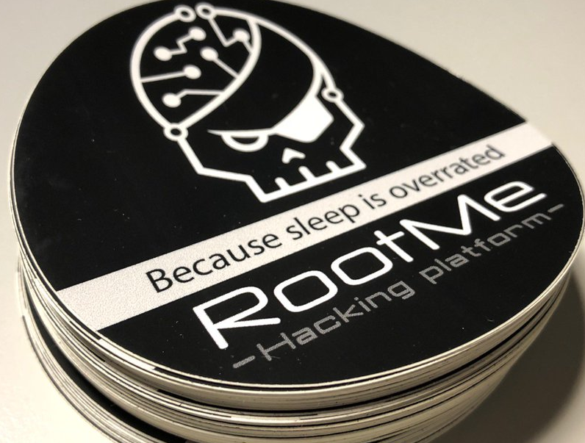
Step1: a well-rested body for more energy

Slide 9

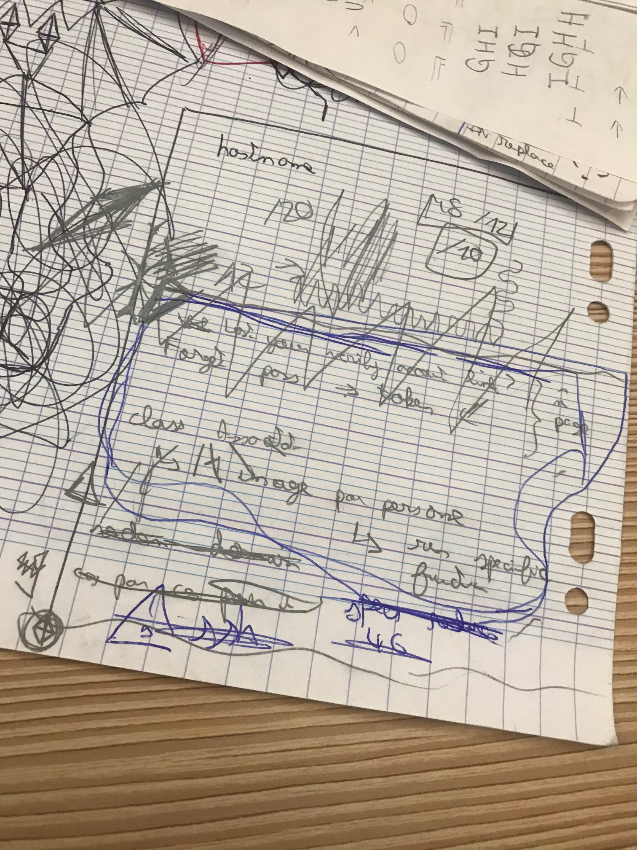

Step2: Take some organized notes

Slide 10

Let’s work !

Slide 11
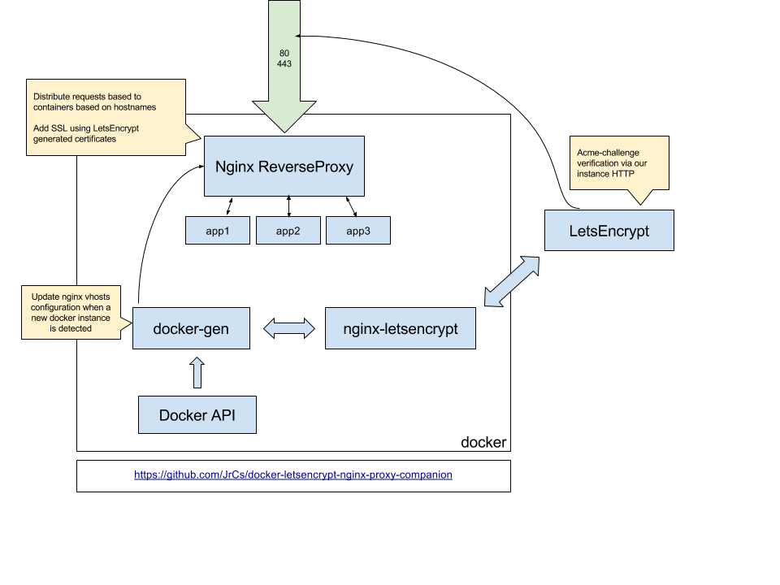



Slide 12
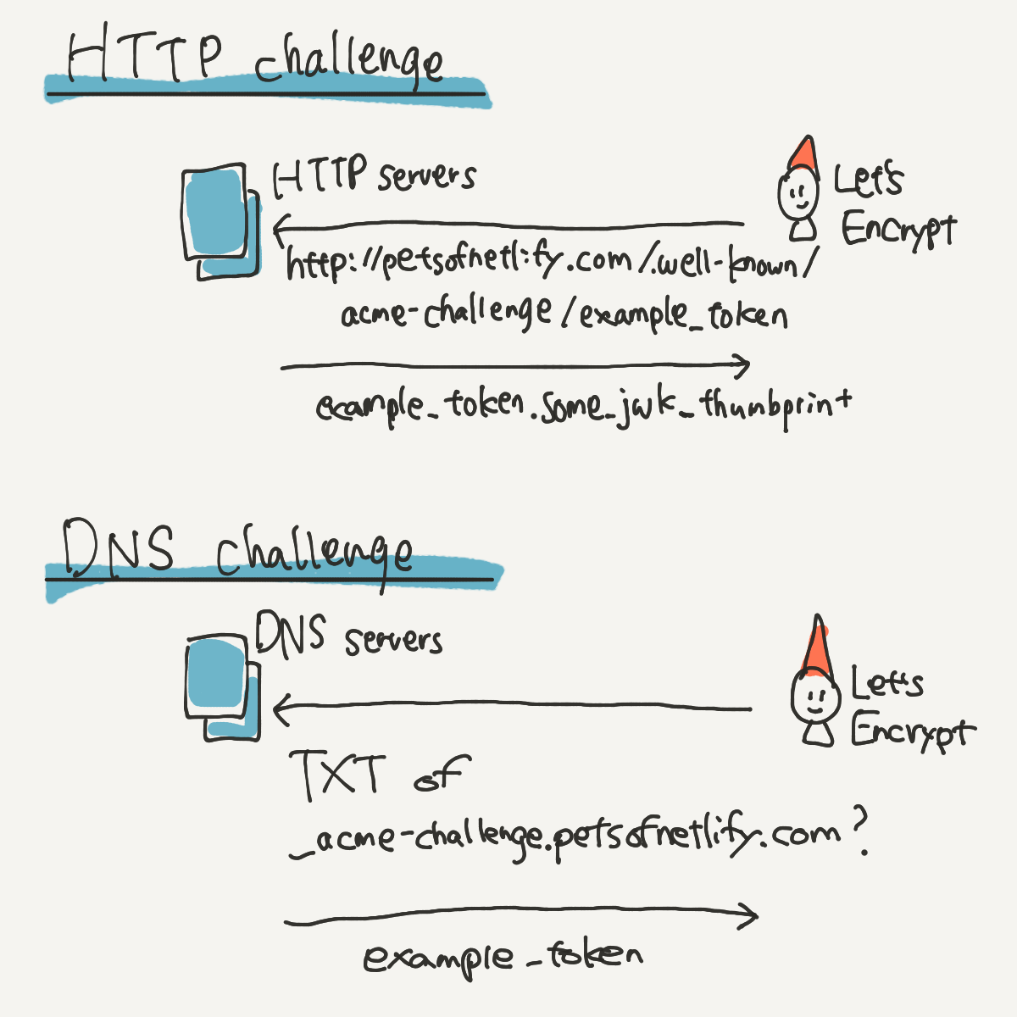
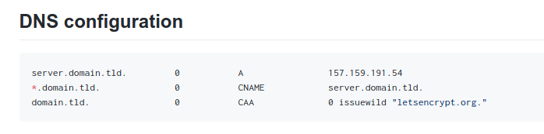
https://letsencrypt.org/fr/docs/challenge-types/
https://thecustomizewindows.com/2017/04/what-is-caa-dns-record-and-how-to-add/

Slide 13
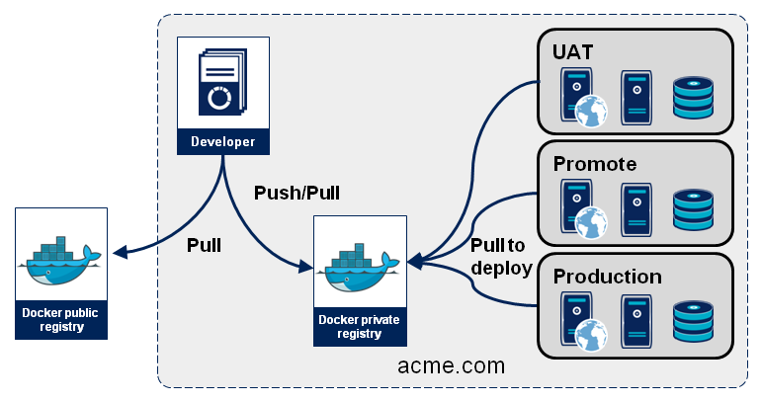

Slide 14
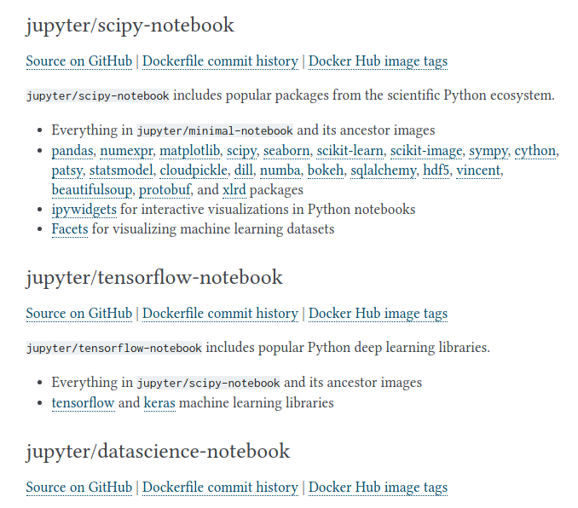



Slide 15
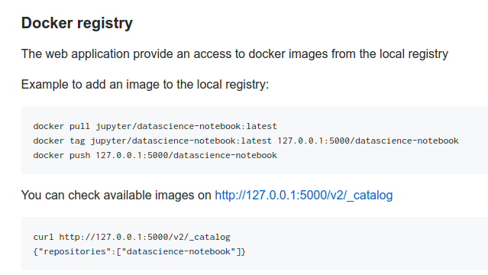

Slide 16
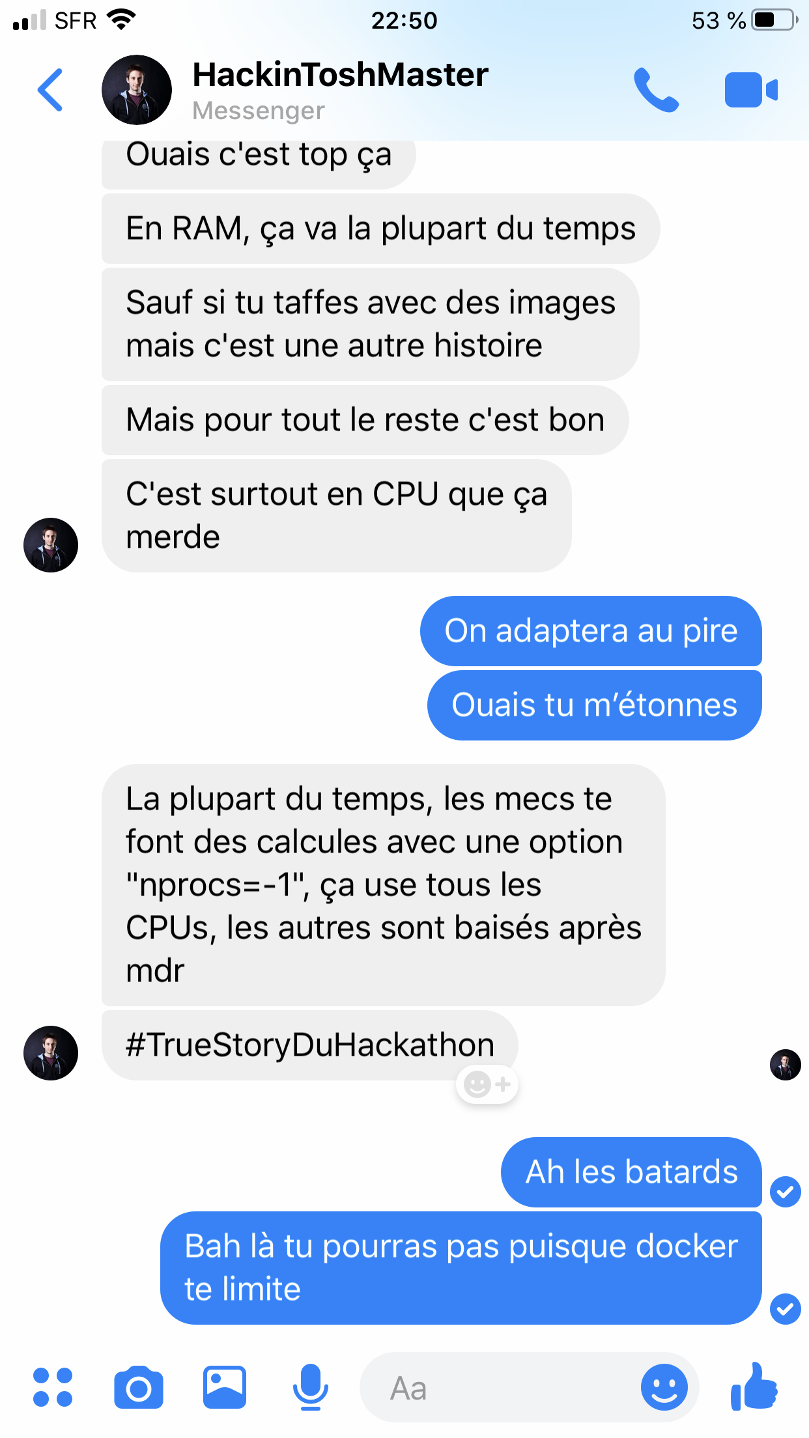
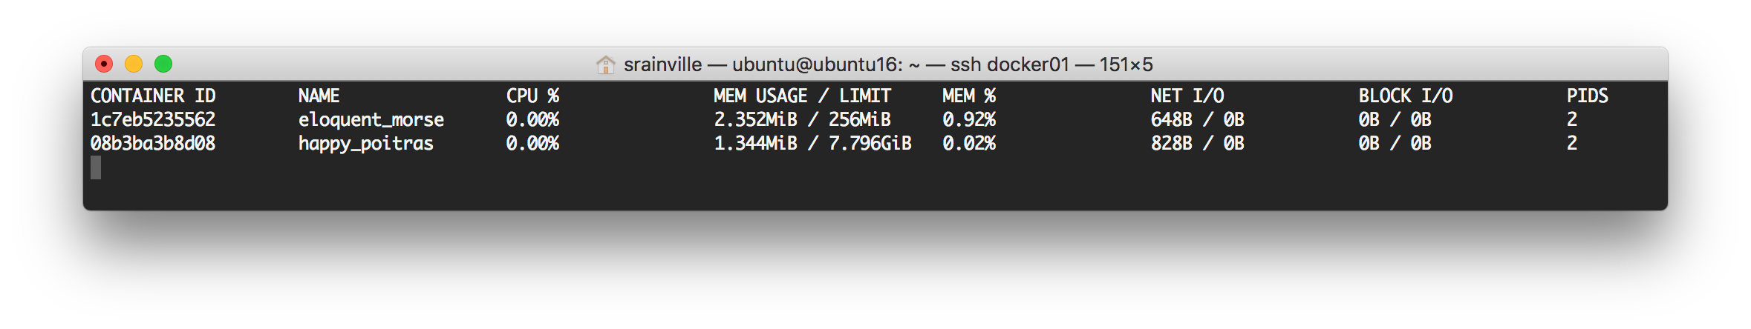
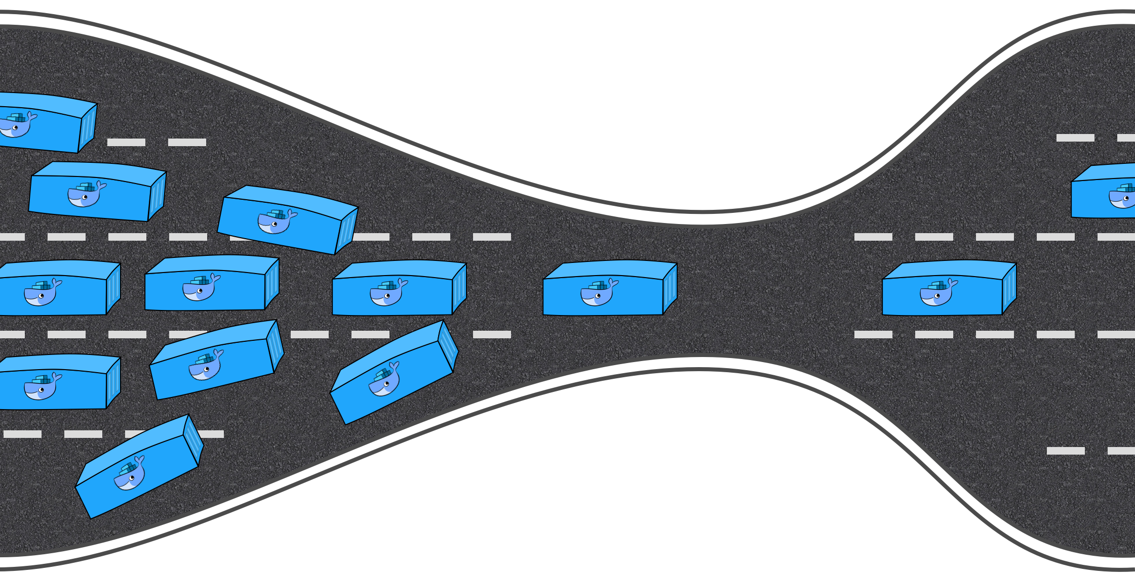
CPU/RAM

Slide 17
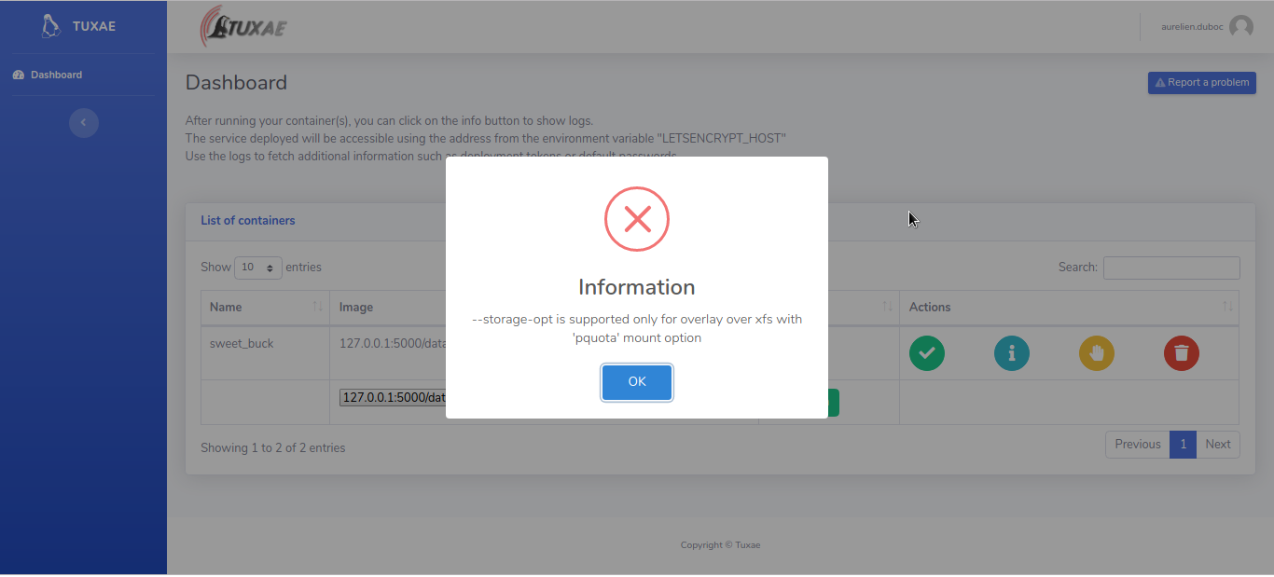
Storage limit issue

Slide 18
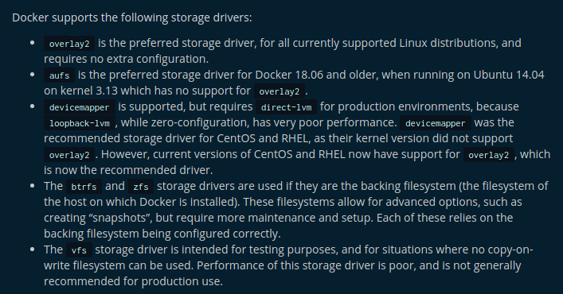
Fixing storage issue
In computing, OverlayFS is a file system for Linux. He has encountered a Union Mount for other file systems. It was merged into the Linux kernel in 2014, in kernel version 3.181.2.
XFS is a high-performance 64-bit log file system created by SGI for its IRIX operating system. In May 2000, SGI places XFS under the GPL license. XFS was ported to the Linux kernel in 2001. Since June 2014, XFS is supported by most Linux distributions, some of which are used as the default file system.
a
a
A disk quota is a limit set by a system administrator that restricts certain aspects of file system usage on modern operating systems. The function of setting quotas to disks is to allocate limited disk-space in a reasonable way.
https://wiki.archlinux.org/index.php/Disk_quota

Slide 19
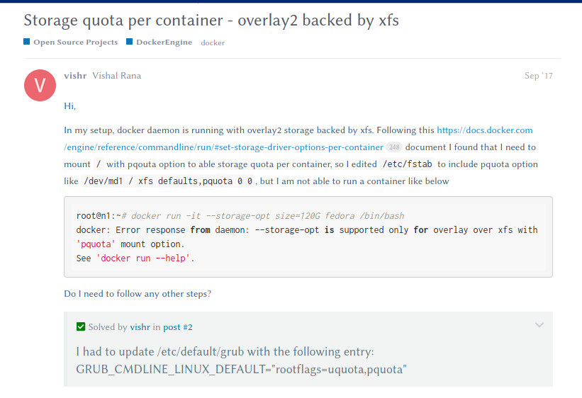

Fixing storage issue

Slide 20
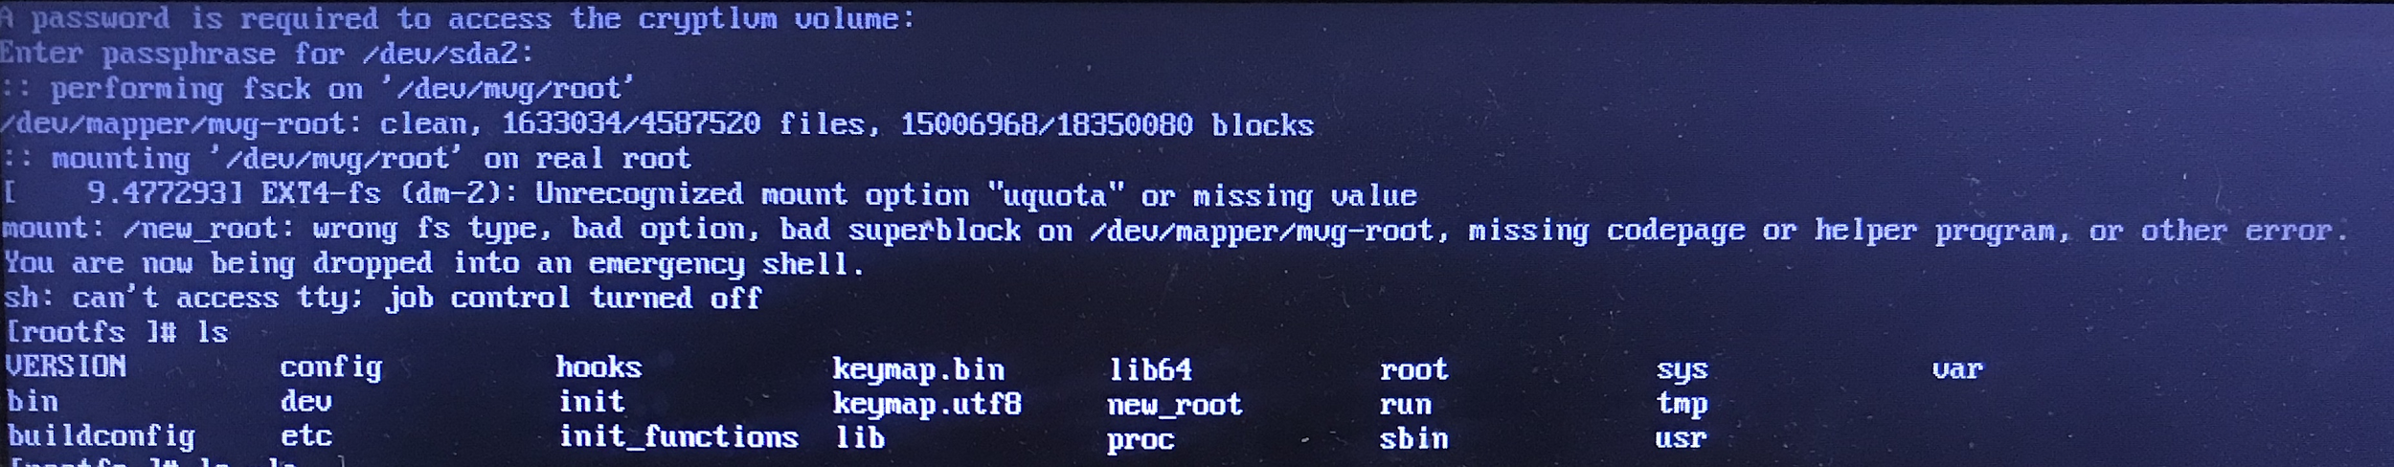
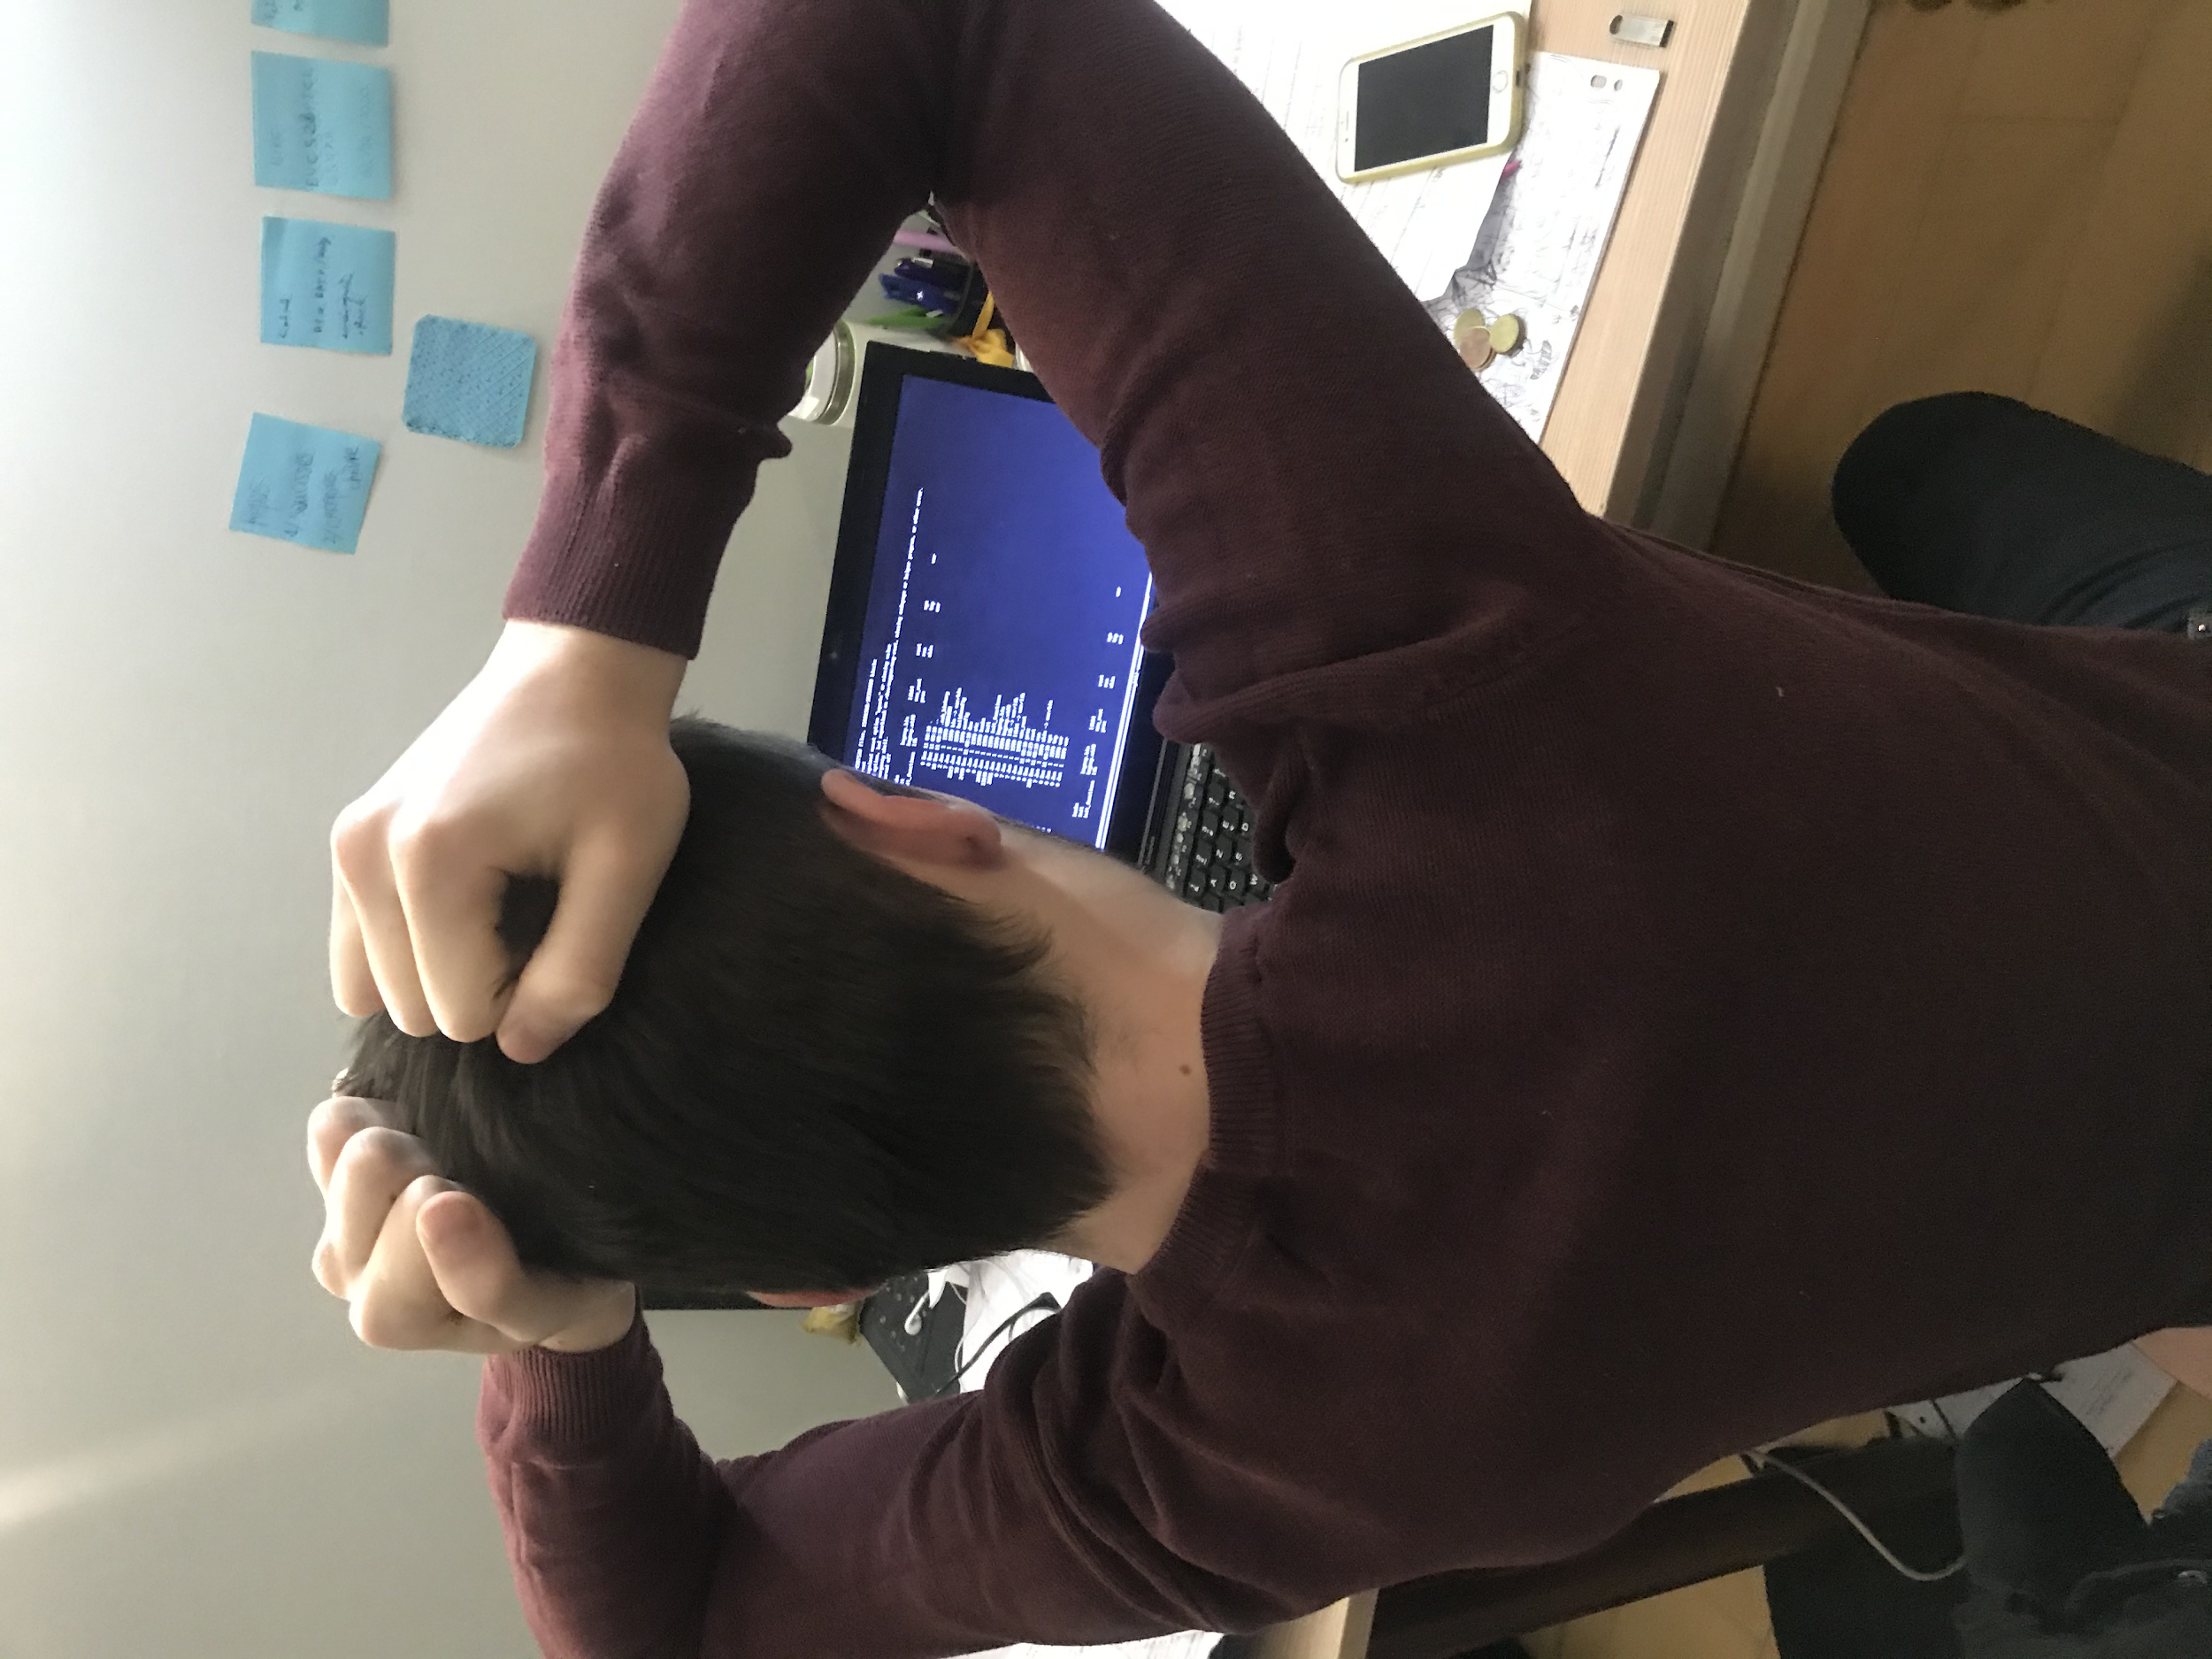
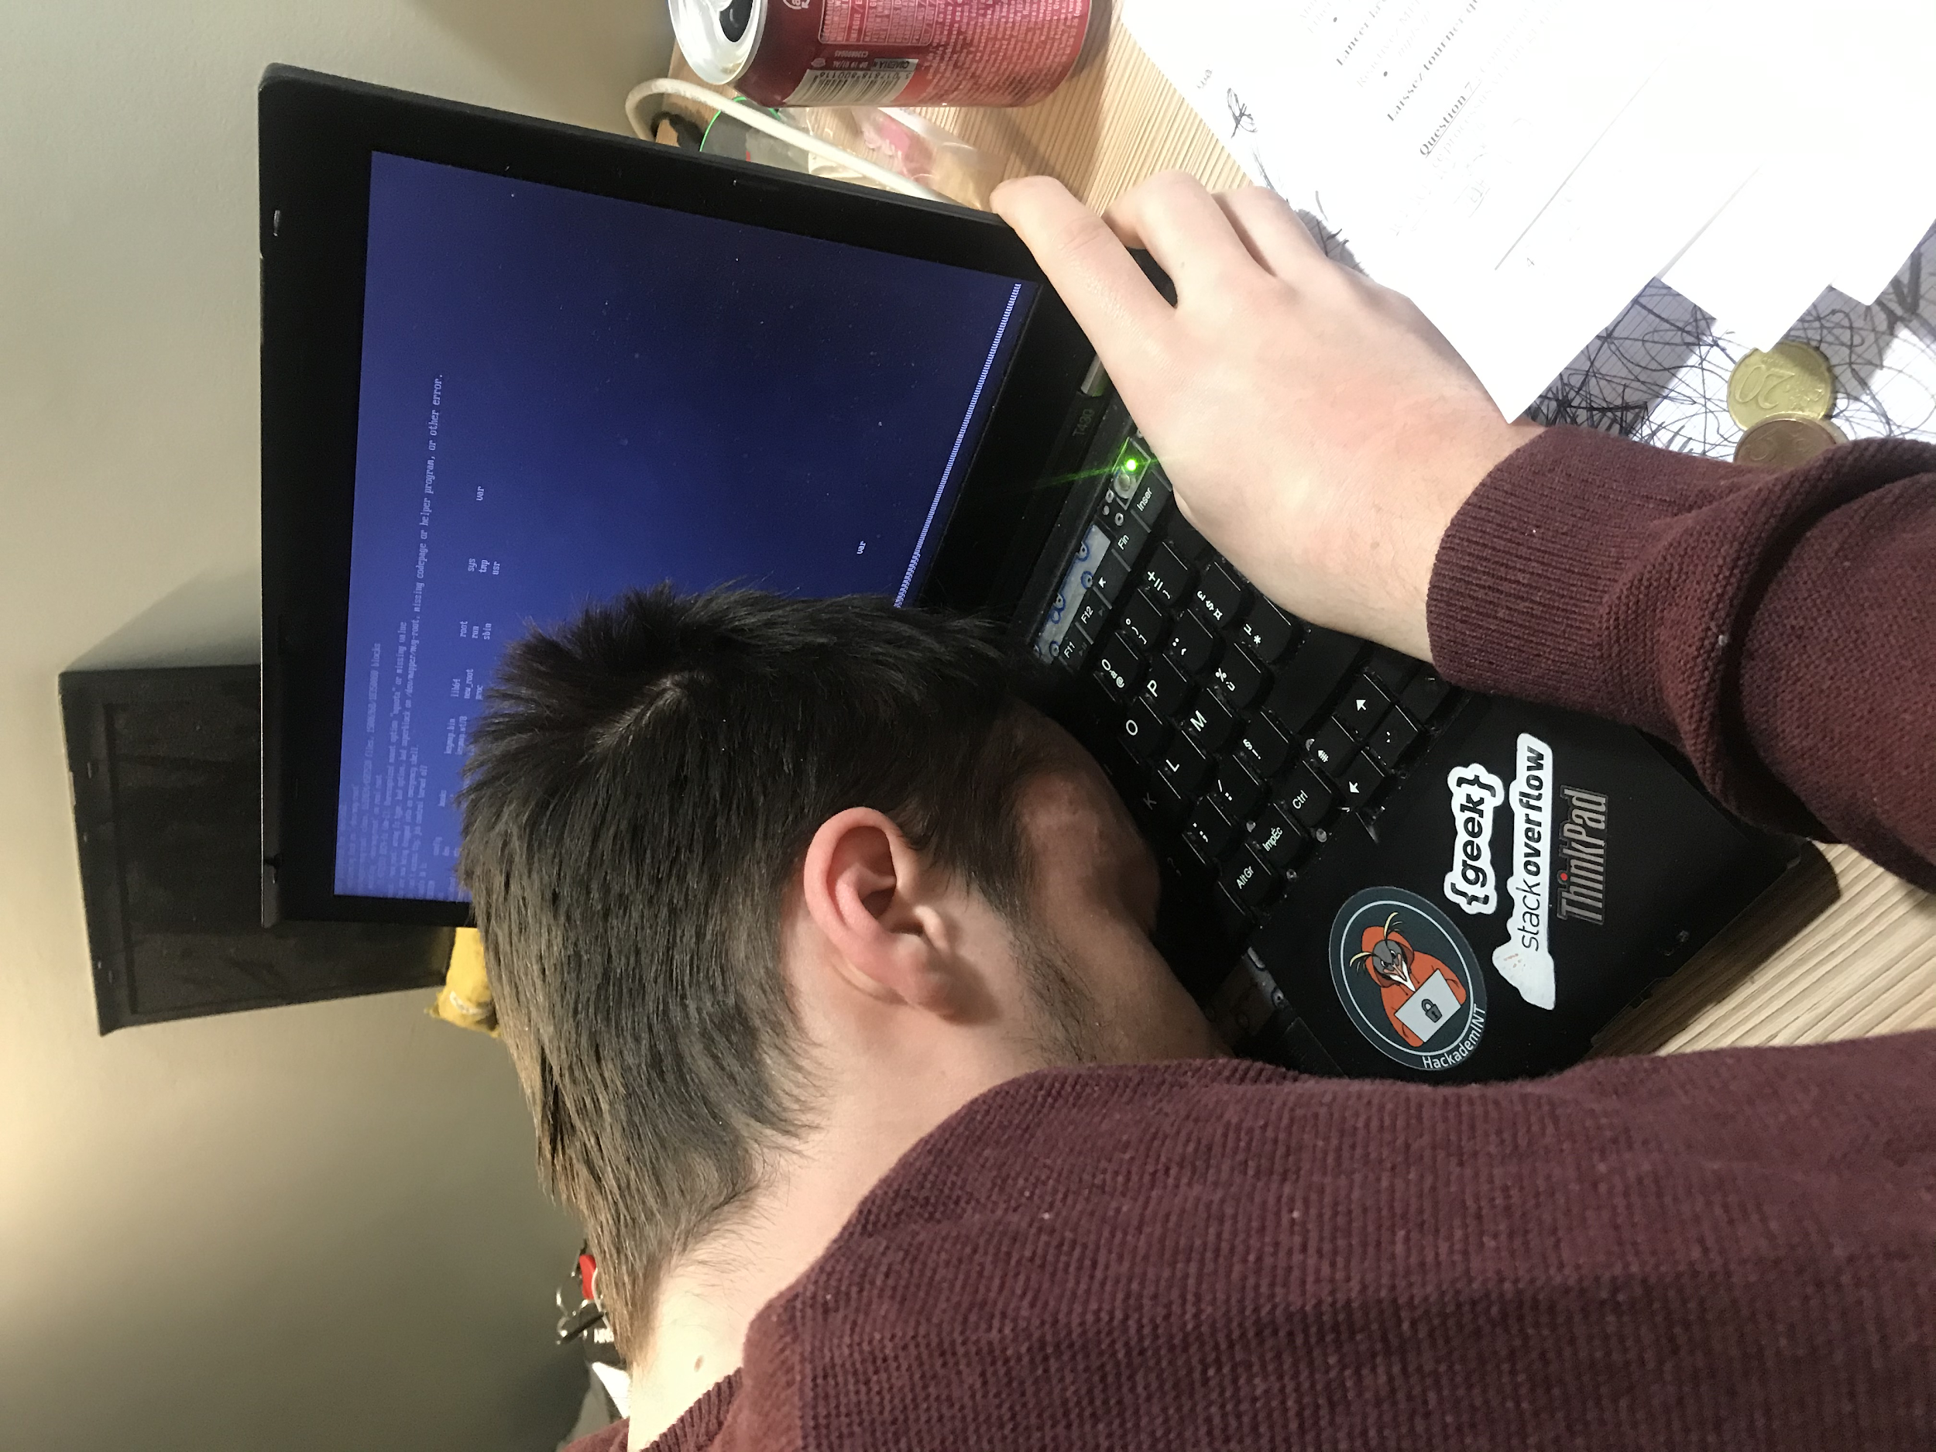
Fixing storage issue
CANNOT BOOT !!

Slide 21
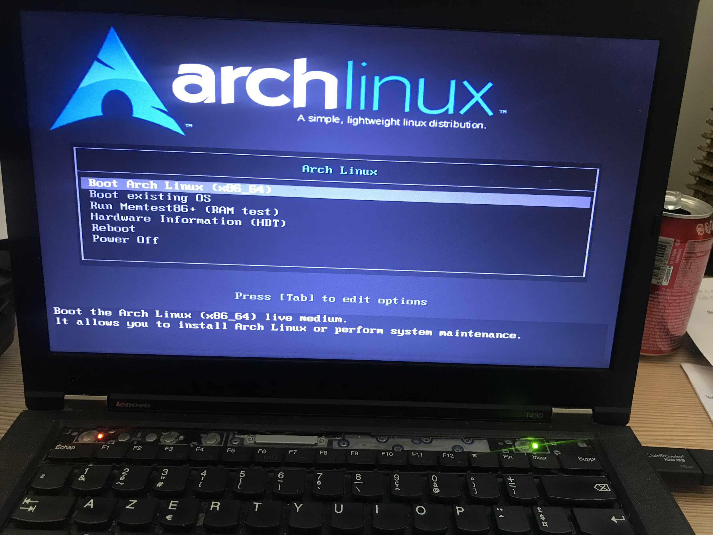
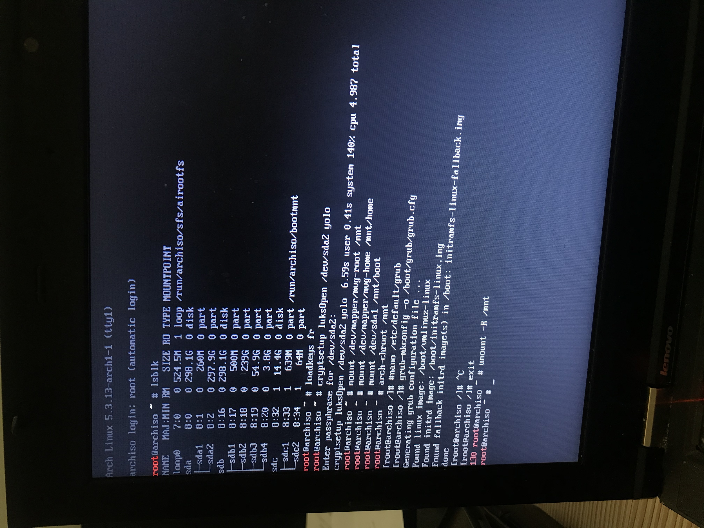
Fixing storage issue
Trying to fix this mess from live OS
Then reboot and pray...

Slide 22


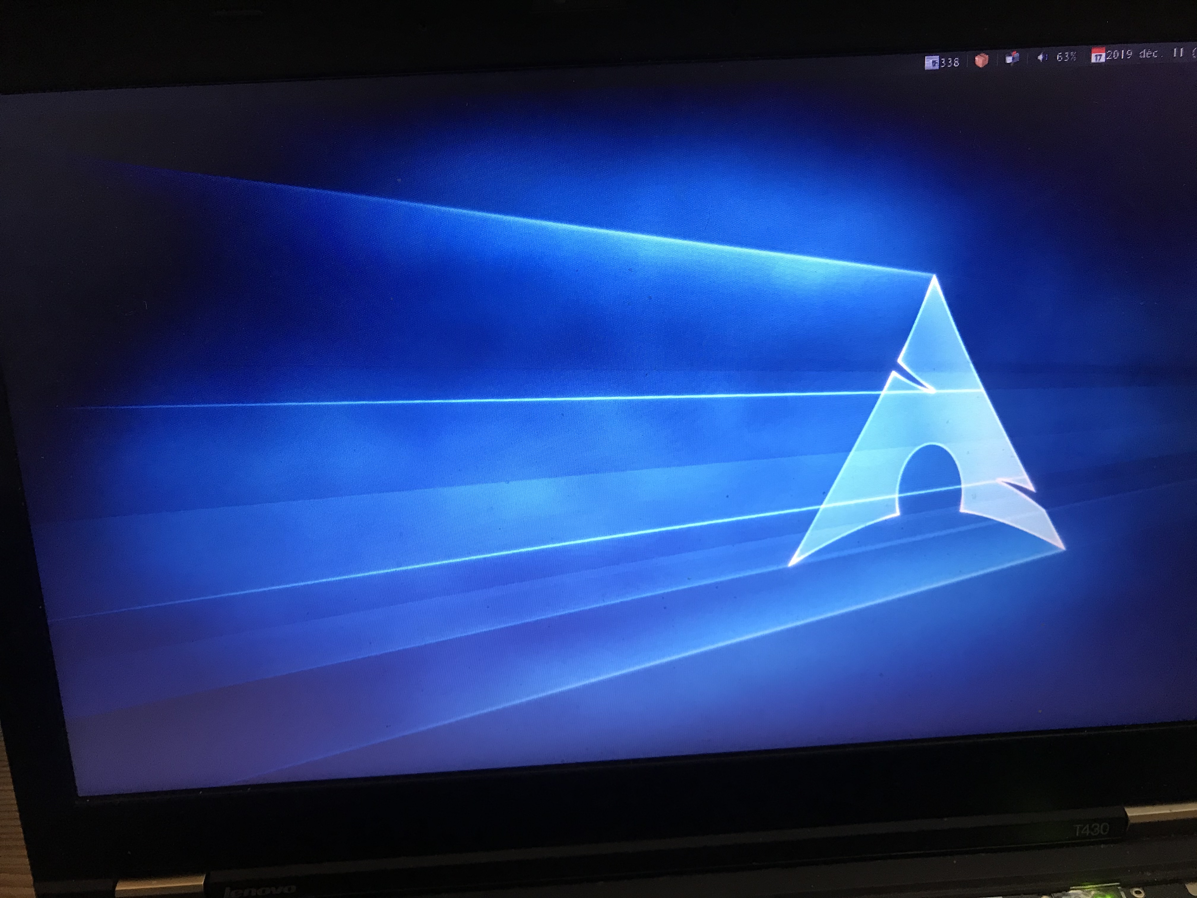

Fixing storage issue
System fixed but no solution...

Slide 23
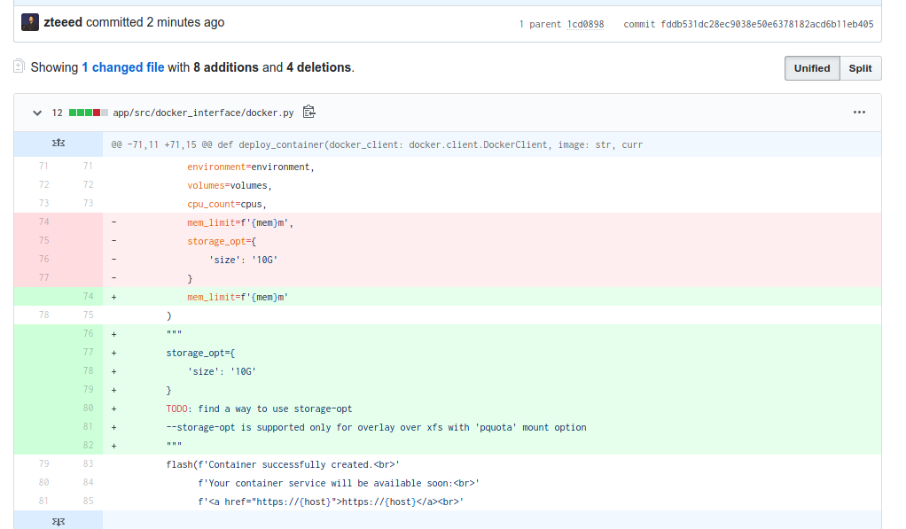
Fixing storage issue
System fixed but no solution...

Slide 24
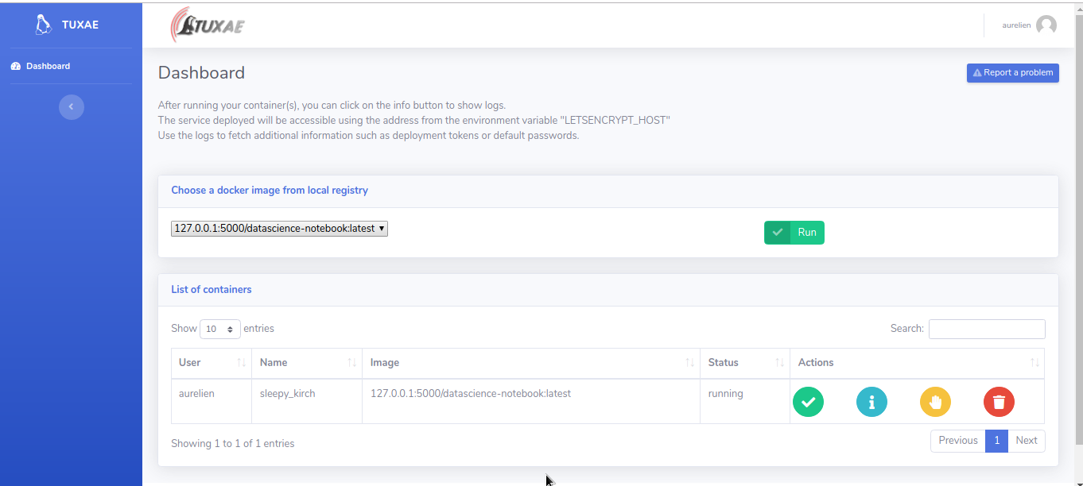

Slide 25
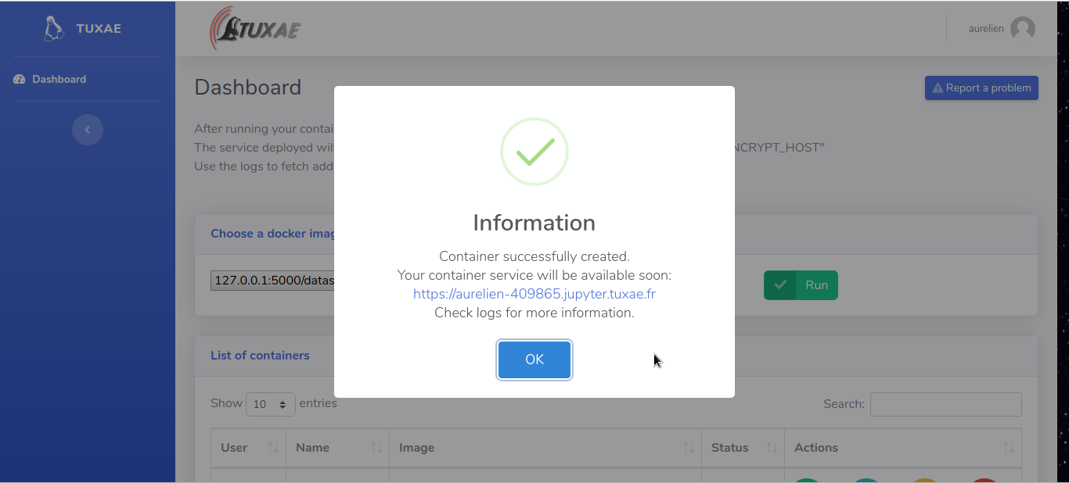

Slide 26
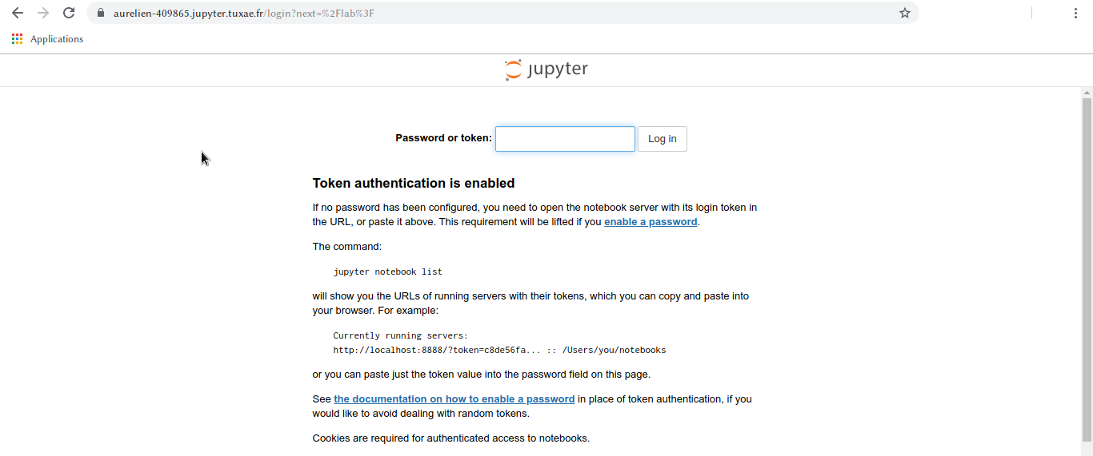

Slide 27
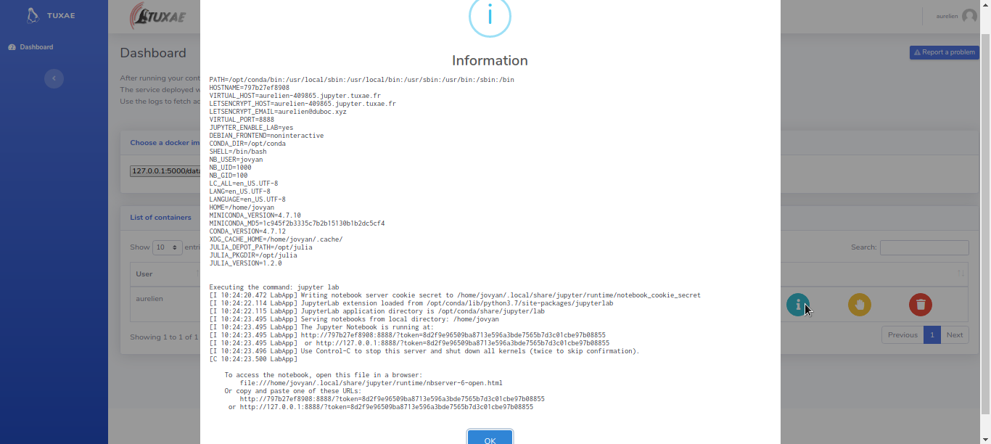

Slide 28
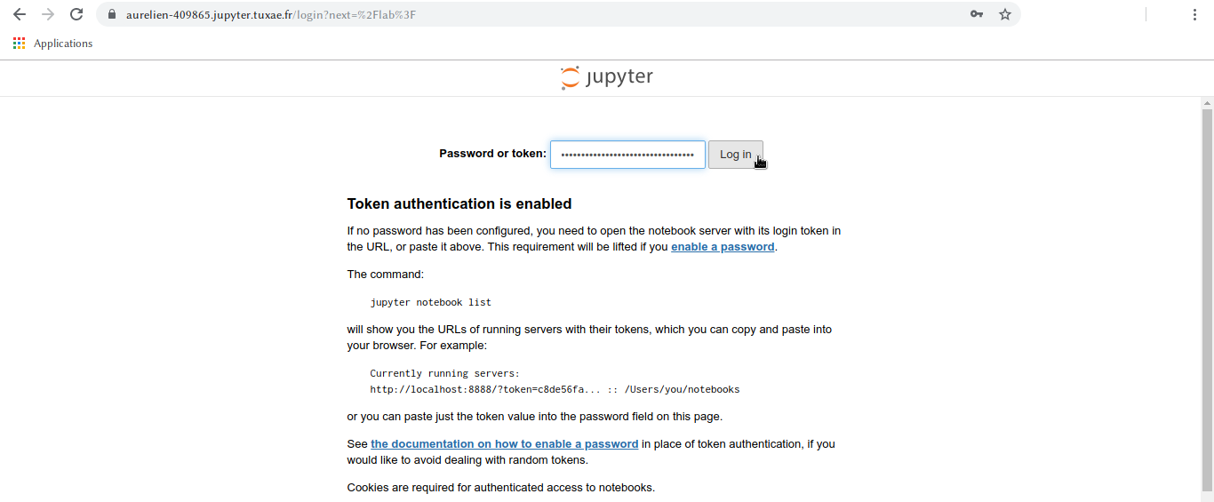

Slide 29
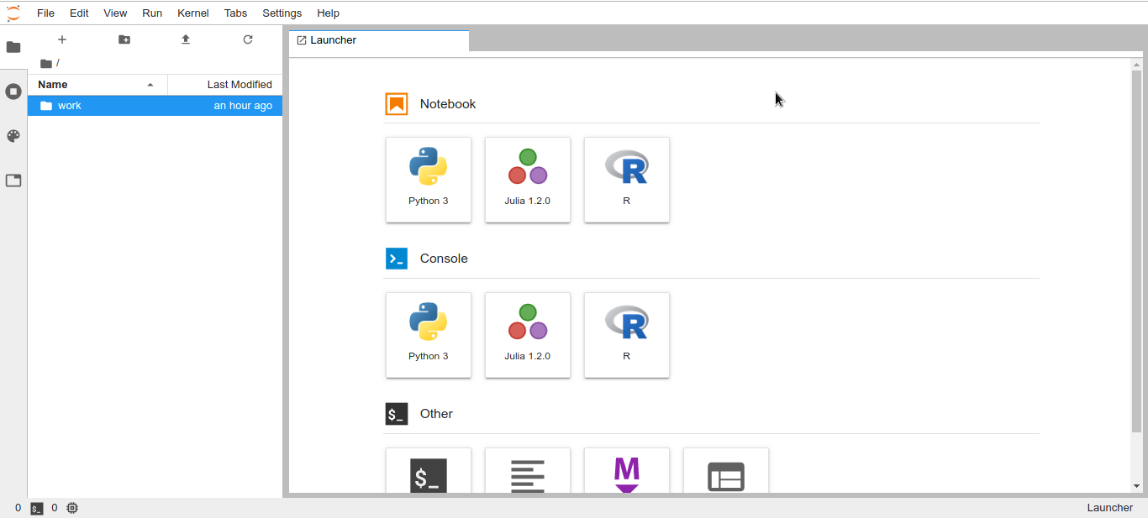

Slide 30
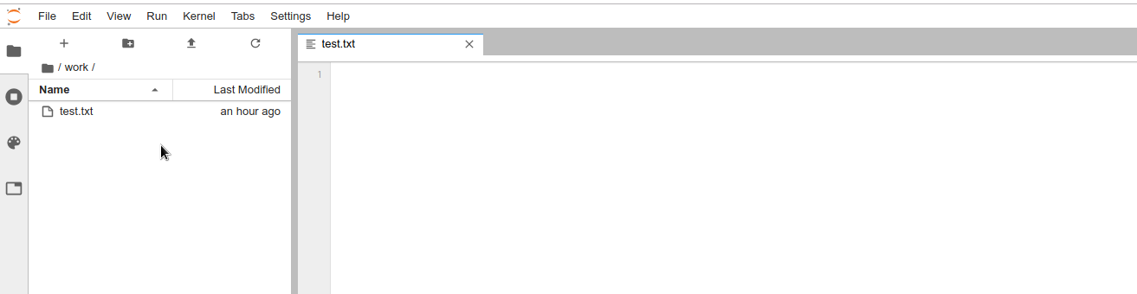
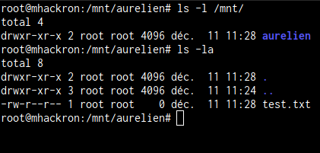

Slide 31
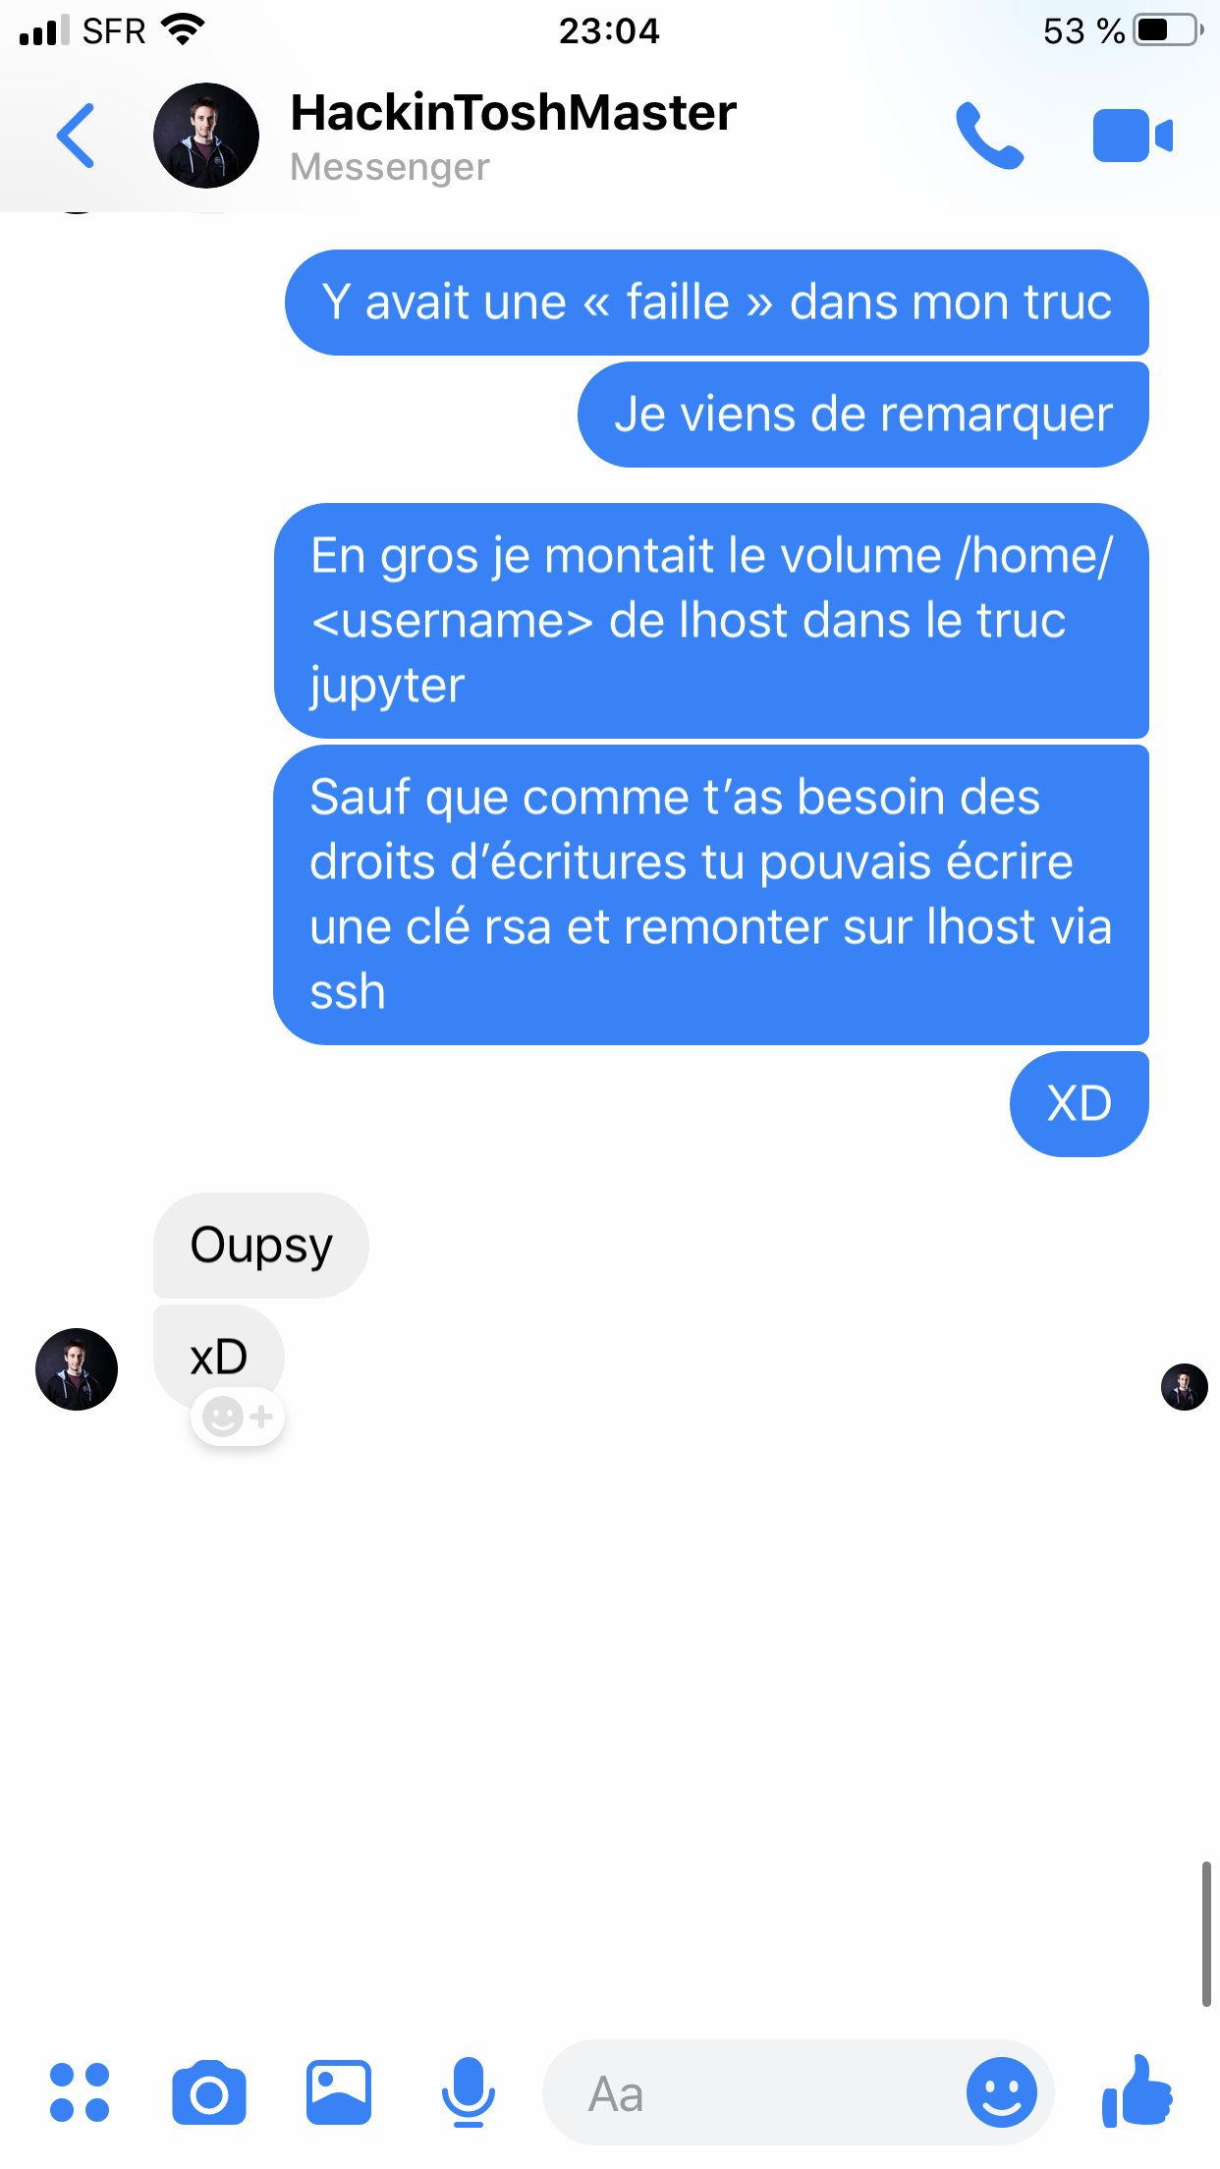


Security issue

Slide 32
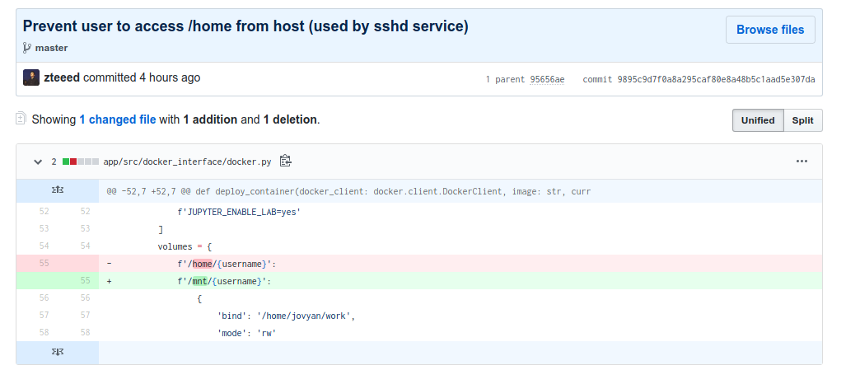

Security issue

Slide 33
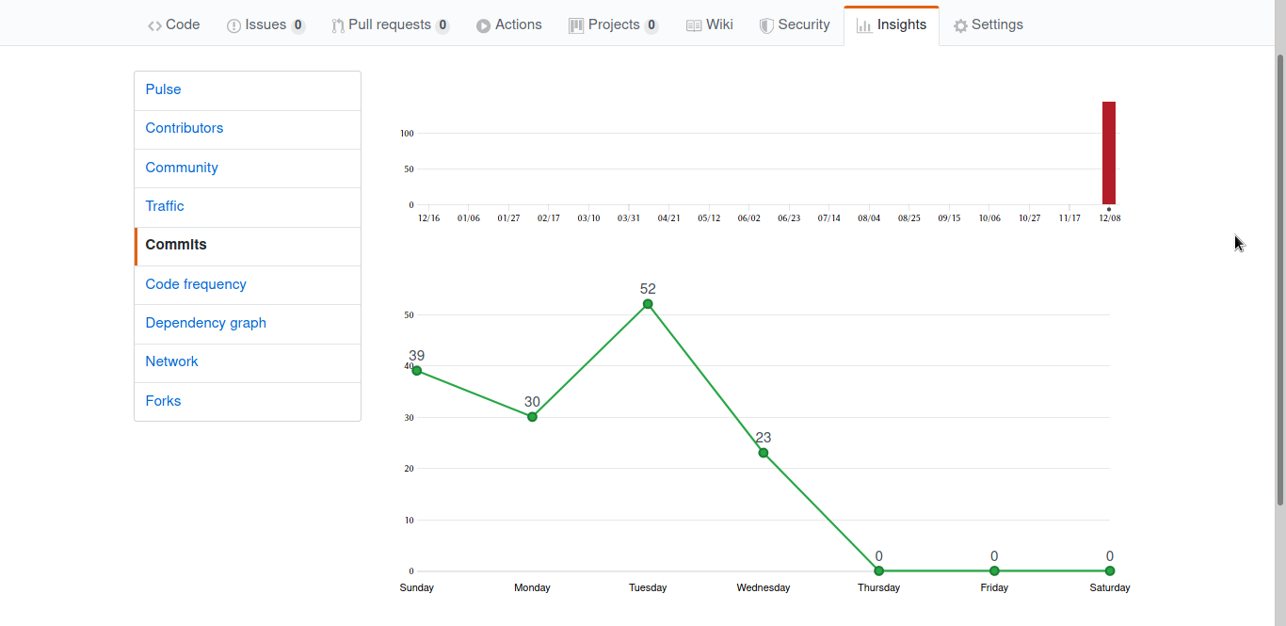

Slide 34
Thank You !

